Slide 1
I-Focus
Group 10-11 Samuel Leong 4S1(17)
Ryan Tan 4S1(21)
Walter Kong 4O3(33)
Songyuan 4S2(20)
Notes:
[ REQUIRES SANSATION AND MUSEO FONT ]
Good morning judges and fellow students. I am Samuel, this is …
And today I am very pleased to present to you our Cat 10 project… I-Focus.

Slide 2
Introduction
Notes:
I-Focus is a project that could possibly change the way we interact with our devices.

Slide 3
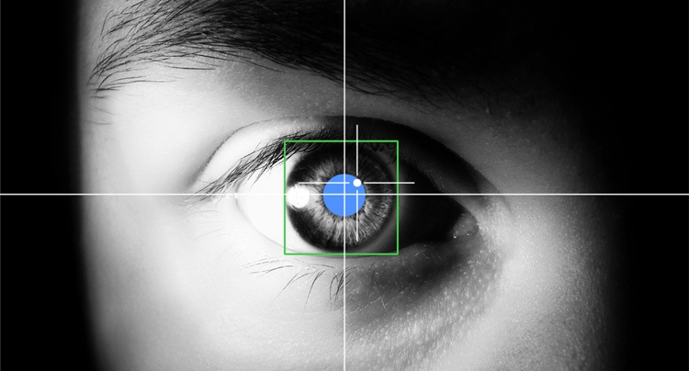
EFFICIENT.
Productive.
INTUITIVE.
Notes:
We are embarking on I-Focus - an EYE-tracking project that aims to use the latest eye-tracking technology and hopefully multi-modal input such as head gestures, in order bring you an efficient, productive and intuitive interface.

Slide 4


Objectives
DSO
Notes:
I-Focus aims to explore, through research with the Defence Science Organisation of Singapore, the most suitable input modes and their accompanying gestures.
This research, of course, will go hand in hand with applications and we will be creating a website along with a host games to be used as a tool to prove that our combination of gestures and input modes can be used by people for efficient, effective and intuitive interface control.

Slide 5

Target Audience
Physically Disabled
General Public
Notes:
And so… our project is aimed particularly at the physically disabled, as they would find our project the most useful. However, our project is likewise perfect for able-bodied individuals like you and I because our project focuses on developing an intuitive interface that combines a host of input technologies

Slide 6

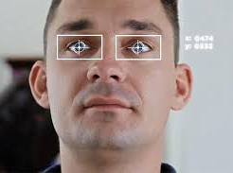
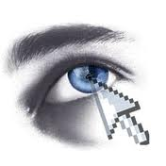
Why I-Focus?
Notes:
[shorten if possible]
So this leads us to answer the question – why I-Focus? Why do we need a revamp in the current forms of mouse and even touchscreen inputs for able-bodied people?
…
3 words: efficiency, effectiveness and intuitiveness
The one-size-fits-all model of kinesthetic input which we get from the mouse is simply inefficient and unintuitive. We use the mouse for everything – clicking, moving, dragging.. And the only reason why we find the mouse pretty effective and efficient is because we have been using it for a long time. [projector screen example] With eye-tracking, everything is fast, efficient and convenient. Just look at where you want to move and click. Look at a link, click on it. Look at an icon, open the application. Efficient. Effective. Intuitive.

Slide 7
Final Products

Slide 8

The Device
EyeTribe Eye-tracker
Affordable
Accurate
Notes:
The device we would be using is the EyeTribe eye-tracker, which is affordable and a lot more accurate than webcams.

Slide 9
Interface Control
Eye-tracking technologies
Multi-modal Input
Efficient.
Effective.
Intuitive.
Notes:
Our project aims to use eye-tracking technologies to explore multi-modal input methods which include head gestures, touch, and clicks, to create a better experience interacting with our daily devices.
But at the end of the day, we would be using mainly eye gestures to create an efficient, effective, and intuitive interface.

Slide 10

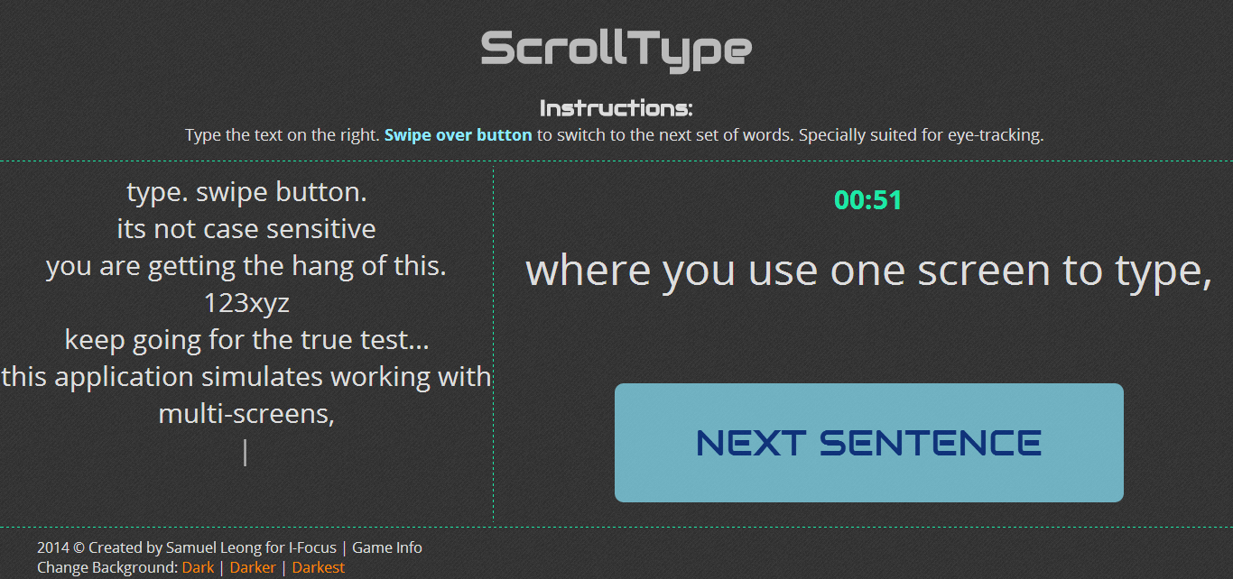

The Applications
Notes:
Our final products will demonstrate the efficiency of eye tracking on applications, websites, and simple games which are deliberately designed to showcase the abilities of eye-tracking.
We will develop a computer application so that users can use eye-tracking and our set of gestures on operating systems as well, such as windows. Eye movements will allow the user to navigate around the screen, just like a cursor, while clicks will be kinesthetic, performed through the click of buttons on the keyboard or a mouse. For the physically disabled, other options for clicks will be made available.
Our interface will be in the form of a website that uses as little clicks as possible and requires the coordination of eye and head gestures to control. In the website, we will feature functions such as navigation with head swipes, eye gestures to activate content, pan and automatically scroll. This website will be accompanied by self-produced and readily available games to allow the user to train his control and accuracy, while at the same time proving how our project can bring about a new level of interface interaction. On the right side is an example of a game that tests the users’ abilities to type while toggling screens using only his eyes.

Slide 11



Programming Languages
HTML 5
CSS 3
JavaScript
#
Notes:
Read off le slides:
HTML
CSS
JavaScript
Flash
C#

Slide 12
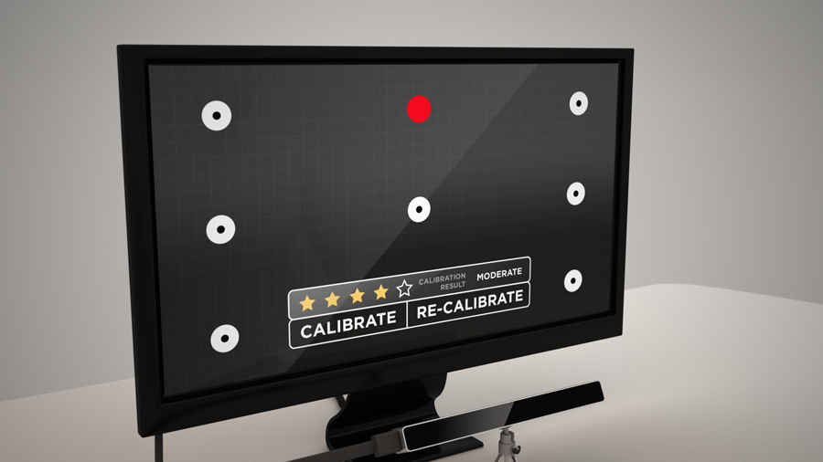
Sneek Peek

Slide 13
Sneek Peek

Slide 14
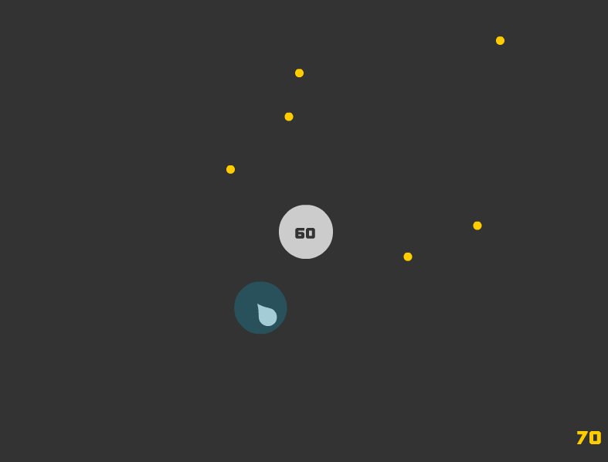
Sneek Peek

Slide 15
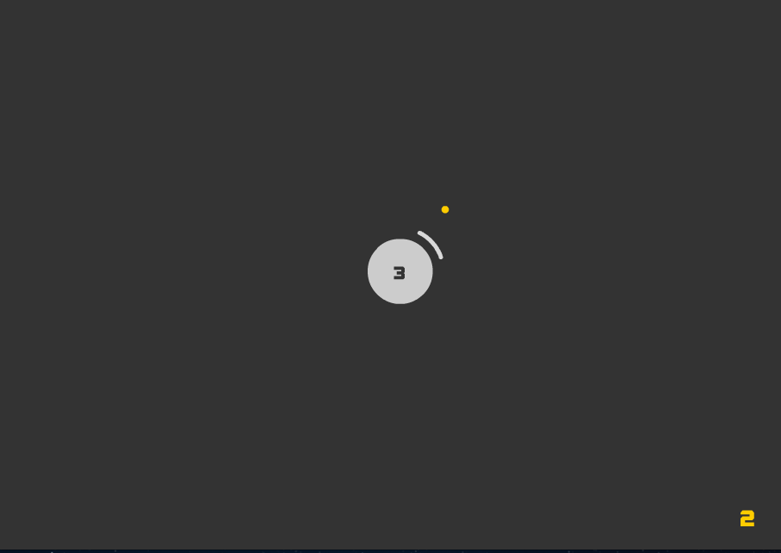
Sneek Peek

Slide 16
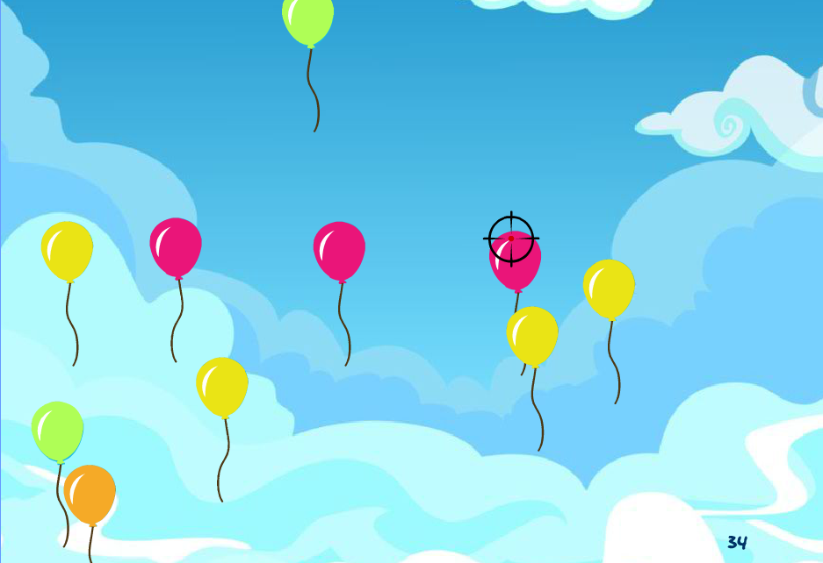
Sneek Peek

Slide 17


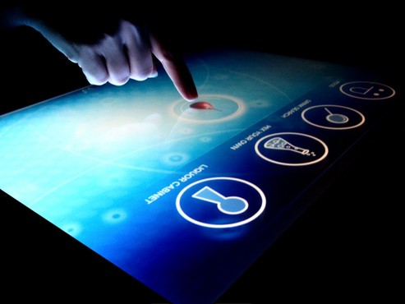
Originality
One-size fits all? Not quite.
Notes:
As of now, the most common form of human computer interaction is still the mouse and keyboard. Although new technologies including the touchscreen and hand gestures may be about to take over, this single mode of kinesthetic input is moving towards a one-size-fits-all approach, which is less efficient and intuitive than the multimodal input which our project focuses on.

Slide 18
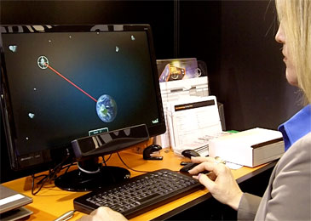
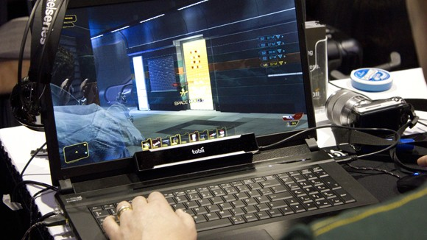
Originality
Efficient. Effective. Intuitive.
Notes:
The point of our project still revolves around the 3 words: efficient, effective, intuitive. We aim to bridge the gap between convenience and functionality by making interactions with everyday devices easy and within reach.
Furthermore, we are one of the first to use multimodal input in the form of eye-tracking, kinesthetic touch and possibly head gestures to create applications that are relevant to the general public’s daily lives, improving their browsing experiences and enhancing interface control.

Slide 19
Survey
Notes:
Many people think that eye-tracking is very feasible and would emerge as a more efficient way of navigating through interfaces. Our of the 93 people we’ve managed to push out the survey to, 72% of the respondents (:DDDDDDD) showed that they would want the ability to control user interfaces using mainly, just their eyes!
Of course, we need to keep in mind the importance of having gestures that are fluid and effective in manipulating user interfaces.

Slide 20
Methodology

Slide 21
Methodology
Exploring current technology
Experimenting with variations
Designing application for optimal interface control
Notes:
Exploring current technology
Experimenting with variations
Designing application for optimal interface control

Slide 22
Partners
Defence Science Organisation of Singapore
External Mentors
Research
Notes:
We will be cooperating with external mentors from the Defense Science Organization of Singapore (DSO) for our research.

Slide 23
Timeline
Notes:
This is our timeline for our project, which is broken down into the following phases.

Slide 24
Job Distribution
Samuel
Walter
Ryan
Songyuan
Programming
Design
Logo
Website
Art
Research
Publicity
Game Design
Console App
Website
Console App
Notes:
Our team will comprise of the programmers, designers and researchers.

Slide 25
Literature Review
Notes:
And in case you are still not convinced…

Slide 26
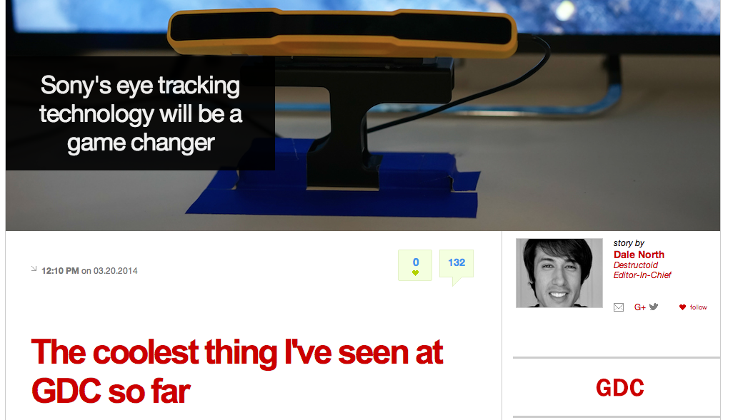
Sony Eye-tracking (Games)
20 March 2014
Notes:
This is an article about Sony’s eye-tracking technology.

Slide 27
Sony Eye-tracking (Games)
It only took a few seconds to get used to, and using the analog stick to compliment eye camera control became natural quickly.
I imagined that aiming and controlling the camera with my eyes would be tiring, but it felt completely natural. Just look and shoot.
http://www.destructoid.com/sony-s-eye-tracking-technology-will-be-a-game-changer-272225.phtml
Notes:
These are some comments from users of Sony’s eye-racking product. They are generally positive as it is responsive and makes gaming easier.

Slide 28
References
http://www.destructoid.com/sony-s-eye-tracking-technology-will-be-a-game-changer-272225.phtml

Slide 29
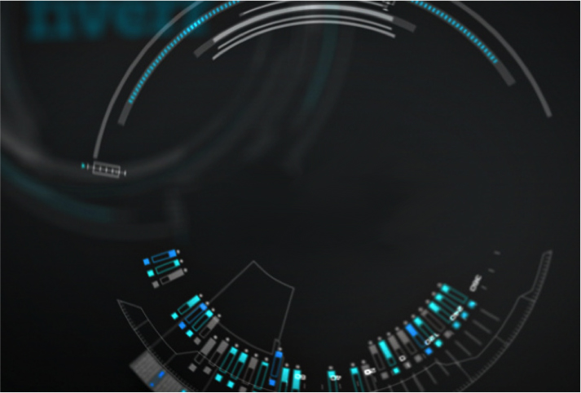
Thank You!

